Slide 1
DATA 300 Statistical Machine Learning
Fall 2023
Chapter 2: Intro to Statistical Learning

Slide 2
Agenda (Chapter 2 in ISLR)
Supervised learning vs unsupervised learning
The goal of supervised learning
Model assessment in regression
Notes:
Supervised learning is a type of machine learning and artificial intelligence. It uses labeled datasets to train algorithms to classify data or predict outcomes.
Unsupervised learning is a machine learning technique that uses algorithms to analyze and cluster unlabeled data sets.

Slide 3
Statistical Learning
What is the relationship between years of education and income?

Slide 4
Statistical Learning
What is the relationship between years of education and income?
e.g., Income = 5k * years of education + unaccounted error
Statistical learning is the process of finding an appropriate functional form to represent the relationship among concepts (variables).
Notes:
A functional form refers to the algebraic form of a relationship between a dependent variable and regressors or explanatory variables.

Slide 5
Refreshing on definitions
A unit or object is an item we observe. When the unit is a person, we refer to the unit as a subject.
An observation is a piece of information or characteristic recorded for each unit.
A characteristic that can vary from unit to unit is called a variable.
In most datasets, every row is often an observation, and every column is often a variable.

Slide 6
Refreshing on definitions
Predictors (independent variable, feature) are the variables used to predict a response.
Response (dependent variable) is the variable being predicted.

Slide 7
Refreshing on definitions
Predictors (independent variable, feature) are the variables used to predict a response. E.g., years of education
Response (dependent variable) is the variable being predicted. E.g., income
Income = 5k * years of education + unaccounted error

Slide 8
Refreshing on definitions
Predictors (independent variables, features) are the variables used to predict a response.
Response (dependent variable) is the variable being predicted.
Identifying predictors and the response requires domain expertise, in other words, the relationship needs to make practical sense in the domain.

Slide 9
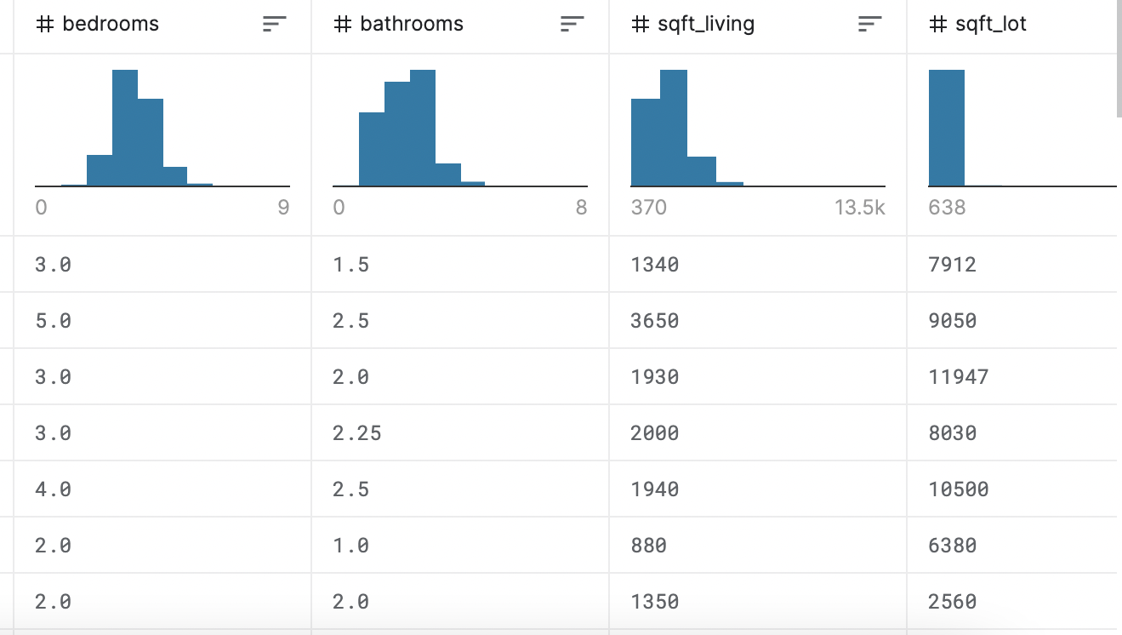
Refreshing on definitions
Predictors (independent variables, features) are the variables used to predict a response.
Response (dependent variable) is the variable being predicted.
Sometimes your data analysis task might not need a Response variable from the dataset, e.g.,
What are the houses that are similar in terms of these four aspects?

Slide 10
Refreshing on definitions
Predictors (independent variables, features) are the variables used to predict a response.
Response (dependent variable) is the variable being predicted.
Sometimes your data analysis task might not need a Response variable from the dataset:
It calls for unsupervised learning models if there is no response (major focus in DATA 180).
Otherwise, the models are called supervised learning models (major focus in DATA 300).

Slide 11
Types of supervised statistical learning
Classification refers to the type of supervised learning models with a categorical response variable, for example:
Is this email a spam or not?
Is this patient diagnosed with cancer or not?
Is this picture a cat or not?
Regression refers to the type of supervised learning models with a continuous (non-categorical) response variable, for example:
Credit card balance of customers.
Students’ grade points from a class.

Slide 12
Agenda (Chapter 2 in ISLR)
Supervised learning vs unsupervised learning
The goal of supervised learning
Model assessment in regression

Slide 13
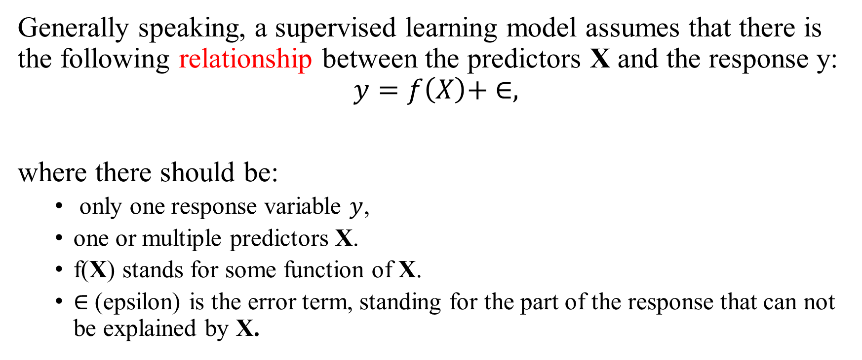
Supervised statistical learning models
Generally speaking, a supervised learning model assumes that there is the following relationship between the predictors X and the response y:
$$y=f\left(X\right)+ ∈,$$
where there should be:
only one response variable $y$,
one or multiple predictors X.
f(X) stands for some function of X.
$∈$ (epsilon) is the error term, standing for the part of the response that can not be explained by X.
Notes:
Relationship typically determined/ labeled by humans

Slide 14

Supervised statistical learning models
Generally speaking, a supervised learning model assumes that there is the following relationship between the predictors X and the response y:
$$y=f\left(X\right)+ ∈,$$
Examples of this functional relationship?

Slide 15
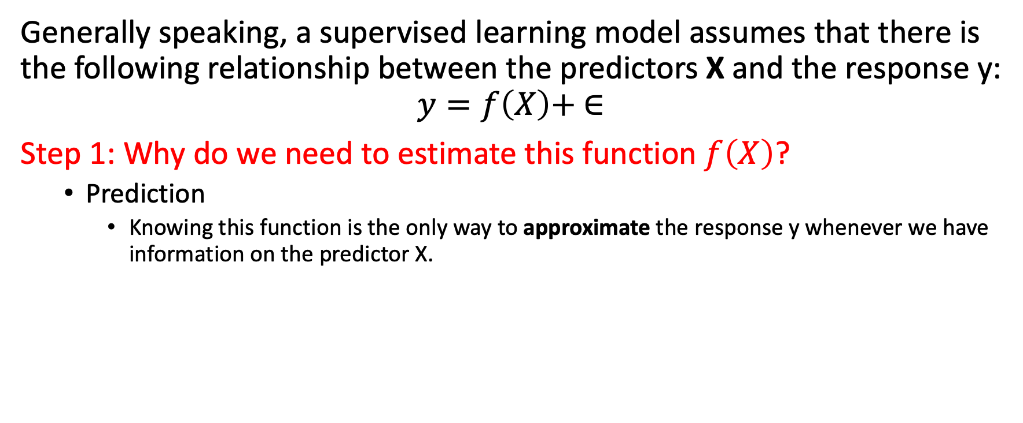
The goal of supervised learning
Generally speaking, a supervised learning model assumes that there is the following relationship between the predictors X and the response y:
$$y=f\left(X\right)+ ∈$$
Step 1: Why do we need to estimate this function $f\left(X\right)$?
Prediction
Knowing this function is the only way to approximate the response y whenever we have information on the predictor X.

Slide 16
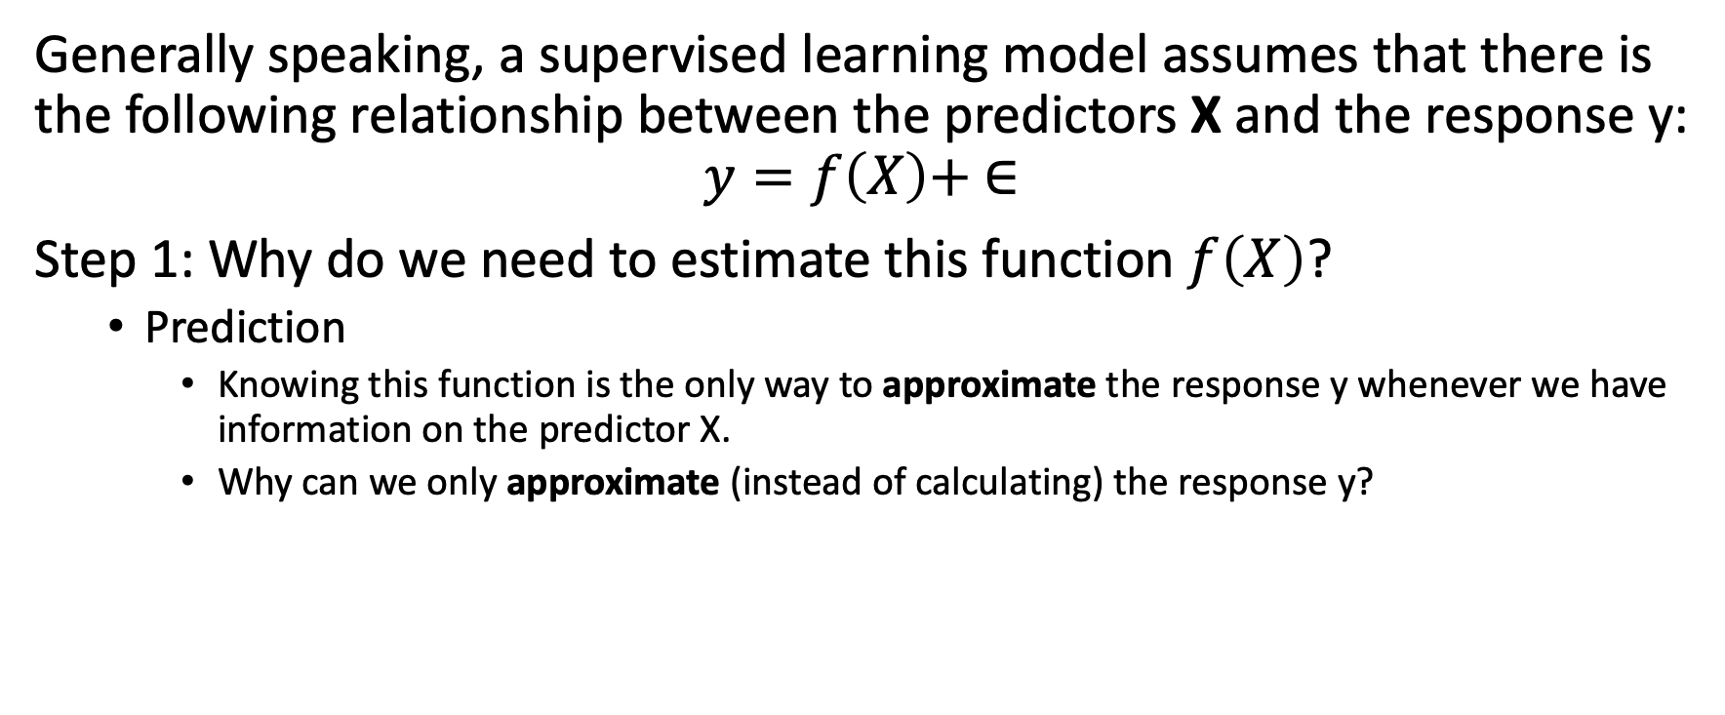
The goal of supervised learning
Generally speaking, a supervised learning model assumes that there is the following relationship between the predictors X and the response y:
$$y=f\left(X\right)+ ∈$$
Step 1: Why do we need to estimate this function $f\left(X\right)$?
Prediction
Knowing this function is the only way to approximate the response y whenever we have information on the predictor X.
Why can we only approximate (instead of calculating) the response y?

Slide 17
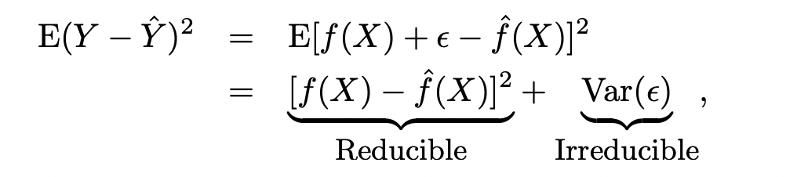
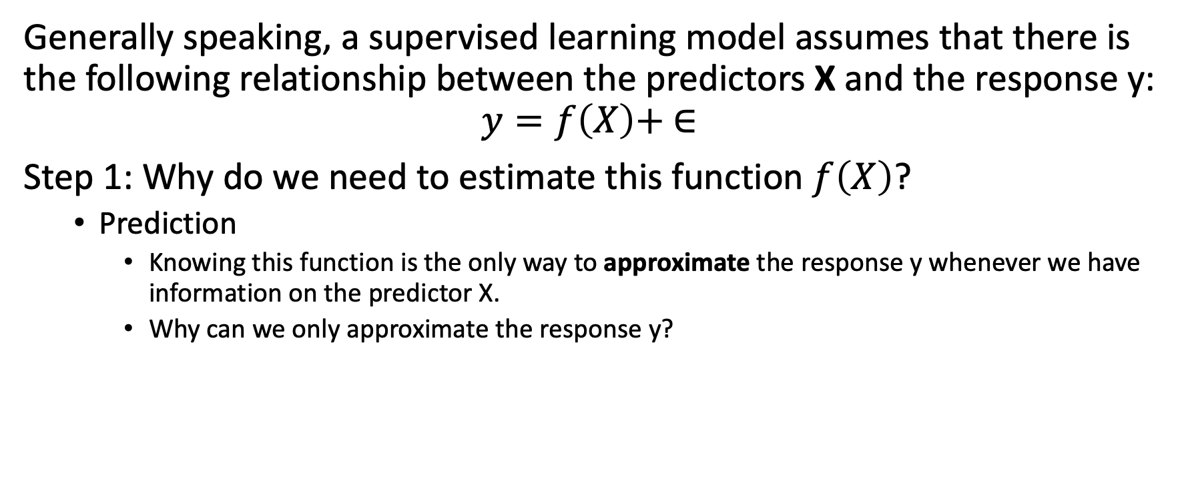
The goal of supervised learning
Generally speaking, a supervised learning model assumes that there is the following relationship between the predictors X and the response y:
$$y=f\left(X\right)+ ∈$$
Step 1: Why do we need to estimate this function $f\left(X\right)$?
Prediction
Knowing this function is the only way to approximate the response y whenever we have information on the predictor X.
Why can we only approximate the response y?

Slide 18
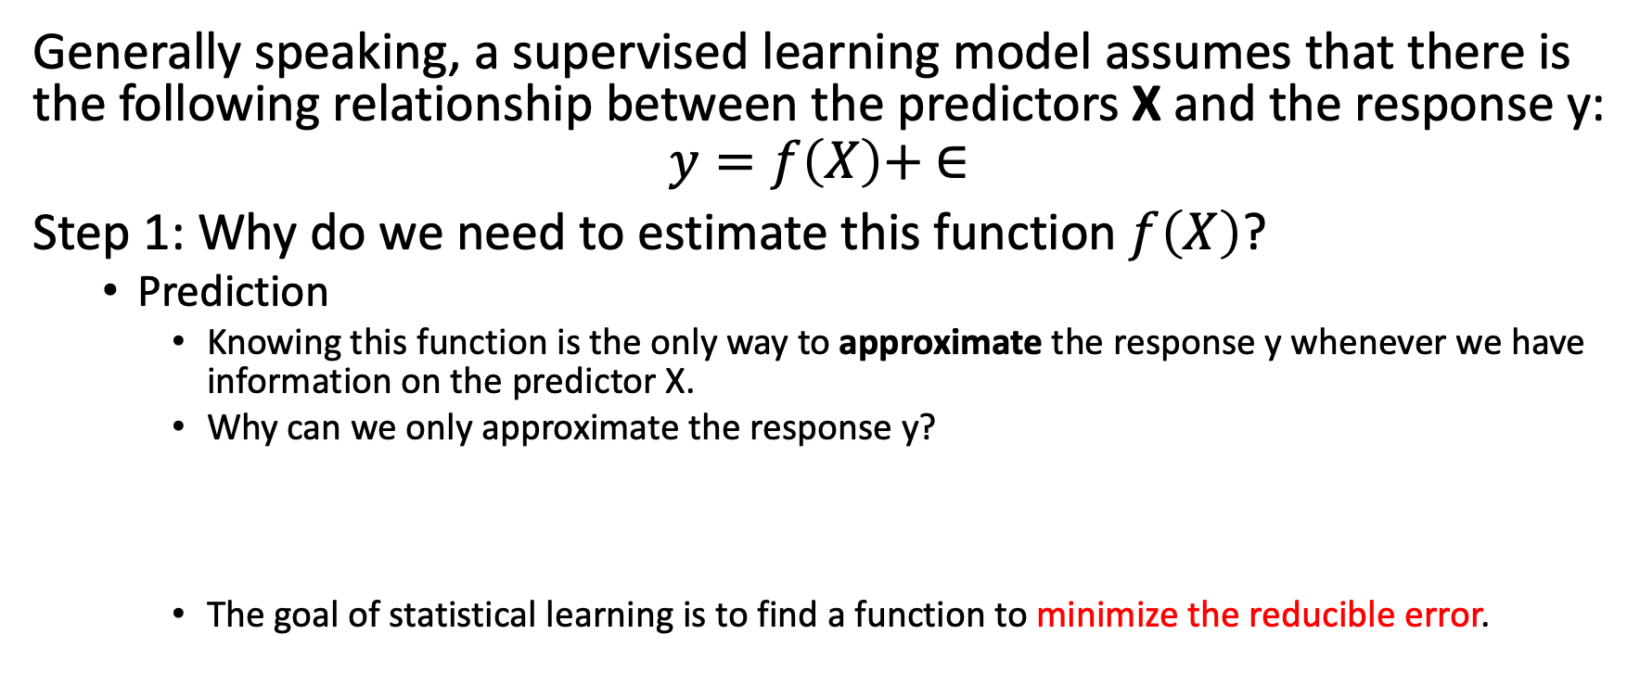
The goal of supervised learning
Generally speaking, a supervised learning model assumes that there is the following relationship between the predictors X and the response y:
$$y=f\left(X\right)+ ∈$$
Step 1: Why do we need to estimate this function $f\left(X\right)$?
Prediction
Knowing this function is the only way to approximate the response y whenever we have information on the predictor X.
Why can we only approximate the response y?
The goal of statistical learning is to find a function to minimize the reducible error.

Slide 19
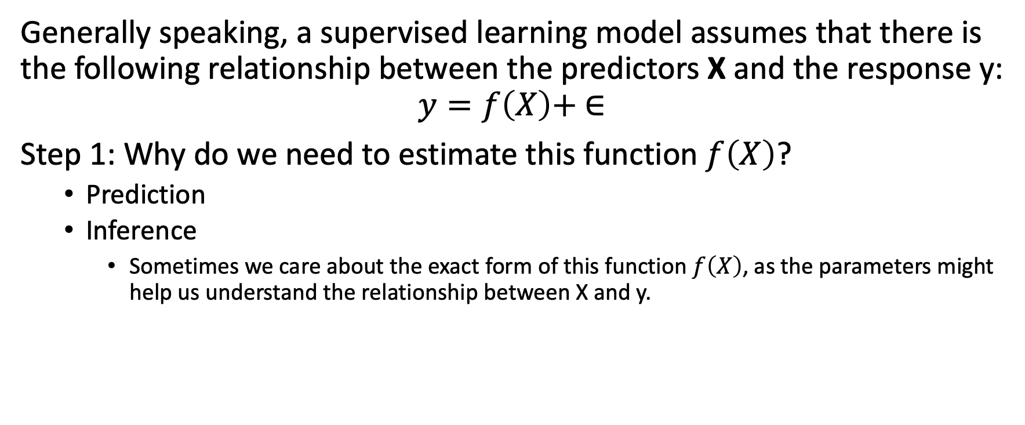
The goal of supervised learning
Generally speaking, a supervised learning model assumes that there is the following relationship between the predictors X and the response y:
$$y=f\left(X\right)+ ∈$$
Step 1: Why do we need to estimate this function $f\left(X\right)$?
Prediction
Inference
Sometimes we care about the exact form of this function $f\left(X\right)$, as the parameters might help us understand the relationship between X and y.

Slide 20

The goal of supervised learning
Generally speaking, a supervised learning model assumes that there is the following relationship between the predictors X and the response y:
$$y=f\left(X\right)+ ∈$$
Step 2: How do we estimate this function $f\left(X\right)$?
Step 2.1: What is the form of f(X)?

Slide 21
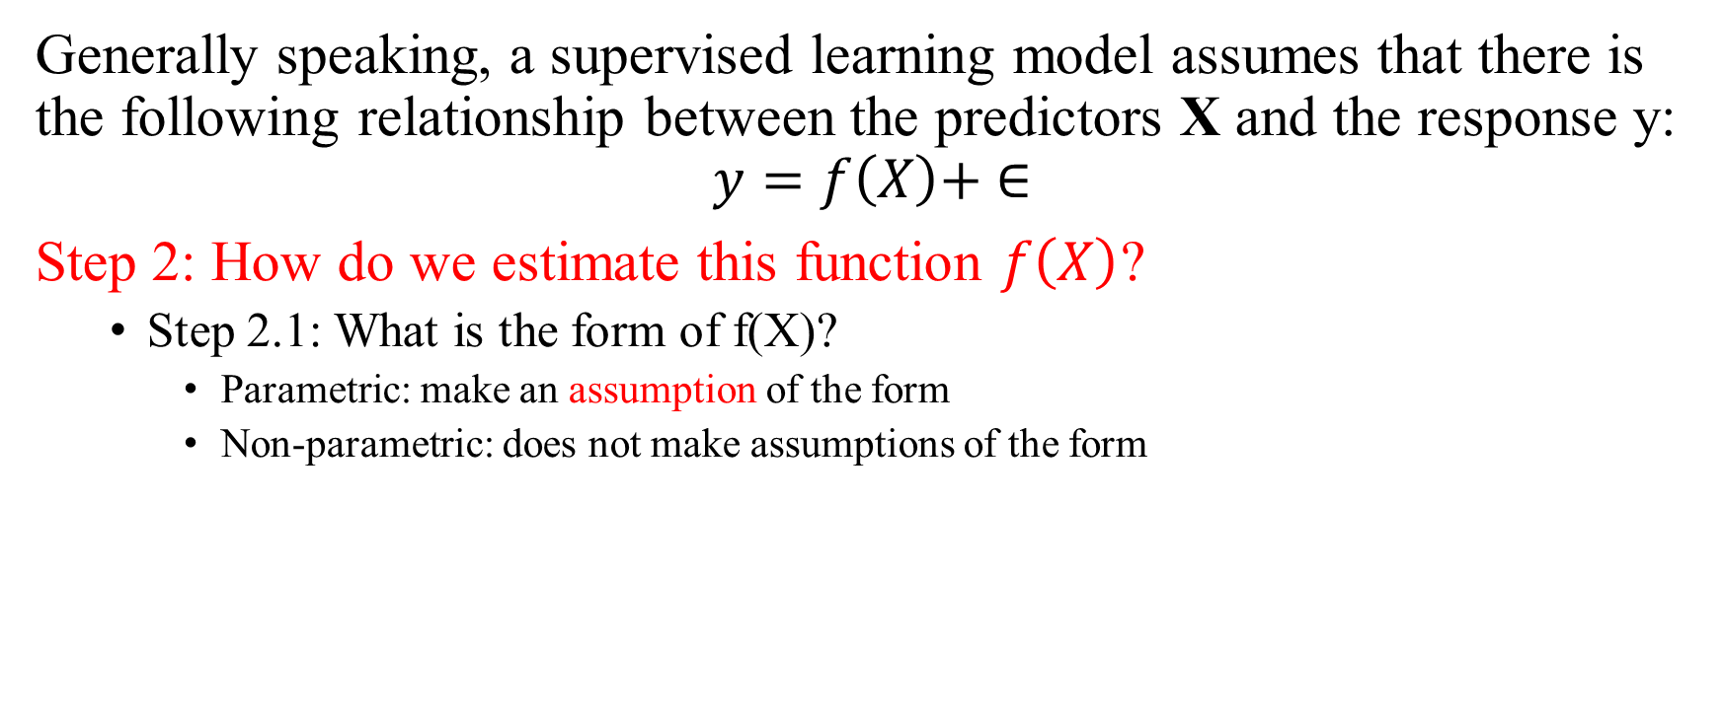
The goal of supervised learning
Generally speaking, a supervised learning model assumes that there is the following relationship between the predictors X and the response y:
$$y=f\left(X\right)+ ∈$$
Step 2: How do we estimate this function $f\left(X\right)$?
Step 2.1: What is the form of f(X)?
Parametric: make an assumption of the form
Non-parametric: does not make assumptions of the form

Slide 22
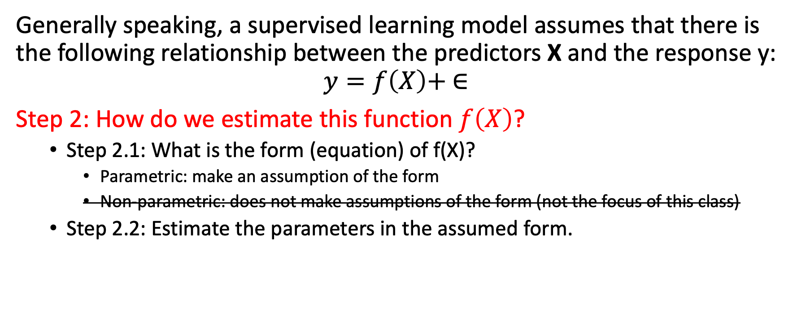
The goal of supervised learning
Generally speaking, a supervised learning model assumes that there is the following relationship between the predictors X and the response y:
$$y=f\left(X\right)+ ∈$$
Step 2: How do we estimate this function $f\left(X\right)$?
Step 2.1: What is the form (equation) of f(X)?
Parametric: make an assumption of the form
Non-parametric: does not make assumptions of the form (not the focus of this class)
Step 2.2: Estimate the parameters in the assumed form.

Slide 23
Exercise
Think about the difference of focus between the following two tasks:
Predict price of Apple’s stock in the next month, and
Analyze what are the factors that have been affecting the stock price for Apple so far.

Slide 24
Exercise
Think about the difference of focus between the following two tasks:
Predict price of Apple’s stock in the next month, and
Analyze what are the factors that have been affecting the stock price for Apple so far.
Why succeeding one task does not mean you can succeed in the other?

Slide 25
Parameter estimation: the trade-off between accuracy and model interpretability
There are always two types of tasks in supervised machine learning:
Prediction (to predict the response y for out-of-sample units)
Interpretation (to explain the relationship between X and y using the sample)
Next, we measure the quality of a model with these two tasks in mind.

Slide 26
Agenda (Chapter 2 in ISLR)
Supervised learning vs unsupervised learning
The goal of supervised learning
Model assessment in regression

Slide 27
Exercise - binary
Assuming the response variable is whether a customer used a coupon in its transaction or not. y = 1 means yes, y = 0 means no. think of a few ways to measure the performance of the following model:
 | True coupon usage | Model predicted usage
Customer 1 | 1 | 1
Customer 2 | 0 | 1
Customer 3 | 1 | 0
Customer 4 | 1 | 1
Customer 5 | 0 | 1

Slide 28
Exercise – non-binary
Assuming the response variable is customers’ monthly expenditure, think of a few ways to measure the performance of the following model:
 | True expenditure | Model predicted expenditure
Customer 1 | $100 | $60
Customer 2 | $120 | $200
Customer 3 | $40 | $50
Customer 4 | $10 | $0
Customer 5 | $80 | $100

Slide 29

Assessing model accuracy: quality of fit
There are a lot of different ways to measure the quality of fit of a model, but they are all about comparing the true response variable y and the predicted response variable $\hat{y}$.

Slide 30
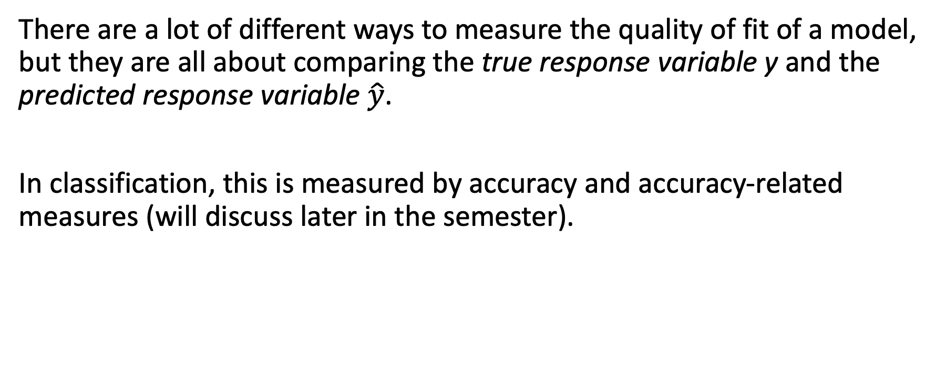
Assessing model accuracy: quality of fit
There are a lot of different ways to measure the quality of fit of a model, but they are all about comparing the true response variable y and the predicted response variable $\hat{y}$.
In classification, this is measured by accuracy and accuracy-related measures (will discuss later in the semester).

Slide 31

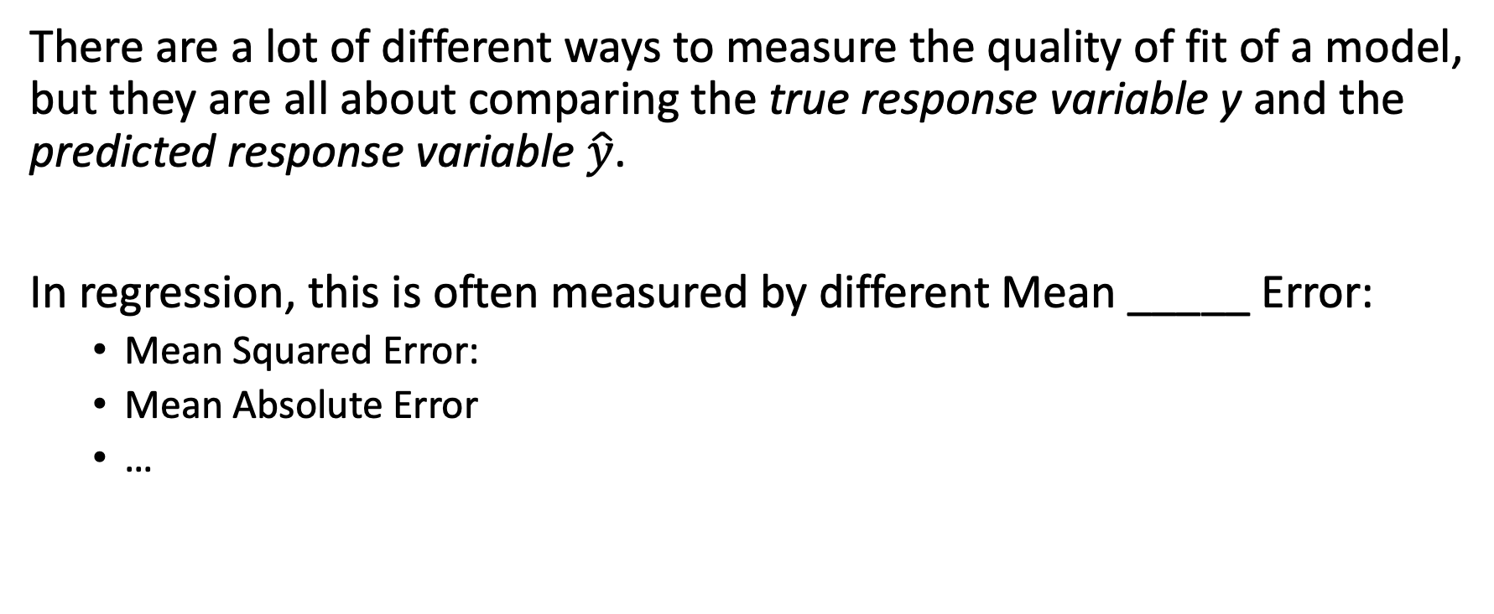
Assessing model accuracy: quality of fit
There are a lot of different ways to measure the quality of fit of a model, but they are all about comparing the true response variable y and the predicted response variable $\hat{y}$.
In regression, this is often measured by different Mean _____ Error:
Mean Squared Error:
Mean Absolute Error
…

Slide 32
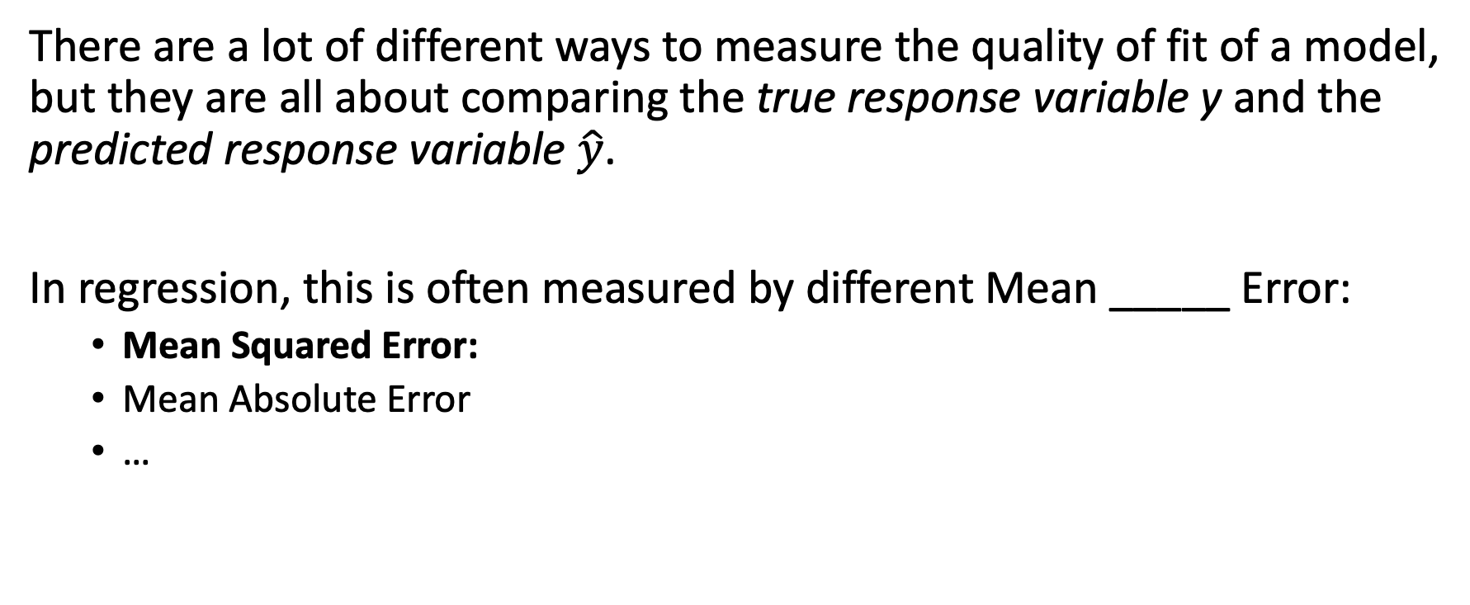
Assessing model accuracy: quality of fit
There are a lot of different ways to measure the quality of fit of a model, but they are all about comparing the true response variable y and the predicted response variable $\hat{y}$.
In regression, this is often measured by different Mean _____ Error:
Mean Squared Error:
Mean Absolute Error
…

Slide 33

Exercise – minimize MSE
To minimize MSE, we are trying to solve the following objective function:
min
Expand the function above.

Slide 34

Assessing model accuracy: bias-variance trade-off
MSE can be decomposed to
In other words, there are three components in MSE:
The variance of the model
The bias of the model.
Irreducible variance that cannot be controlled by the model.

Slide 35
Assessing model accuracy: bias-variance trade-off
MSE can be decomposed to
In other words, there are three components in MSE:
The variance of the model
The amount of change in the model when we change the training set.
The bias of the model
The error introduced by using a model to approximate a real-life problem.
Irreducible variance that cannot be controlled by the model.

Slide 36
Exercise
MSE can be decomposed to
In other words, there are three components in MSE:
The variance of the model
The amount of change in the model when we change the training set.
The bias of the model
The error introduced by using a model to approximate a real-life problem.
Irreducible variance that cannot be controlled by the model.
Think practically: if a model is simple (linear regression), what tends to happen for variance and bias?
What about a more complicated model?

Slide 37
Assessing model accuracy: bias-variance trade-off
MSE can be decomposed to
In other words, there are three components in MSE:
The variance of the model
The amount of change in the model when we change the training set.
Tend to be low if the model is simple and less flexible.
The bias of the model
The error introduced by using a model to approximate a real-life problem.
Tend to be low if the model is flexible and complicated.
Irreducible variance that cannot be controlled by the model.

Slide 38
Assessing model accuracy: bias-variance trade-off
MSE can be decomposed to
In other words, there are three components in MSE:
The variance of the model
The amount of change in the model when we change the training set.
Tend to be low if the model is simple and less flexible.
The bias of the model
The error introduced by using a model to approximate a real-life problem.
Tend to be low if the model is flexible and complicated.
Irreducible variance that cannot be controlled by the model.
Hence, it is challenging to find a model that can reduce variance and bias at the same time.

